Slide 1


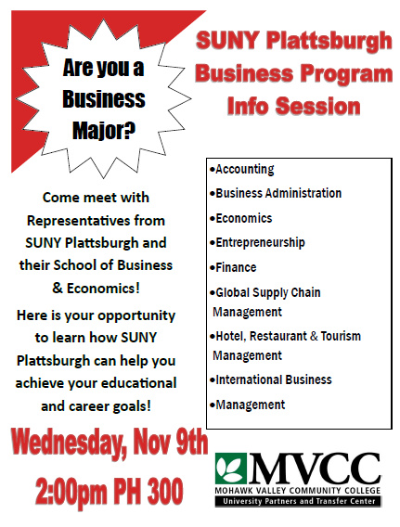

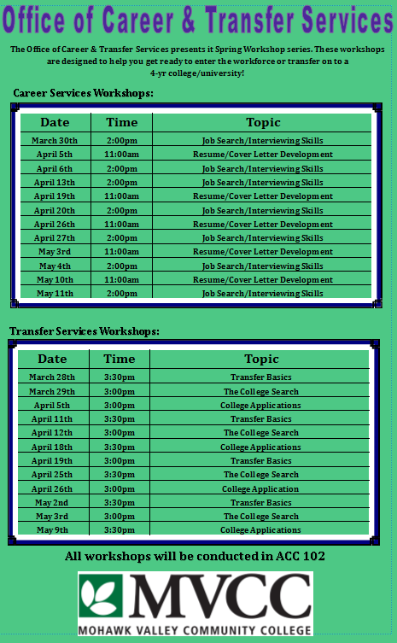
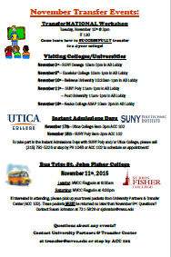



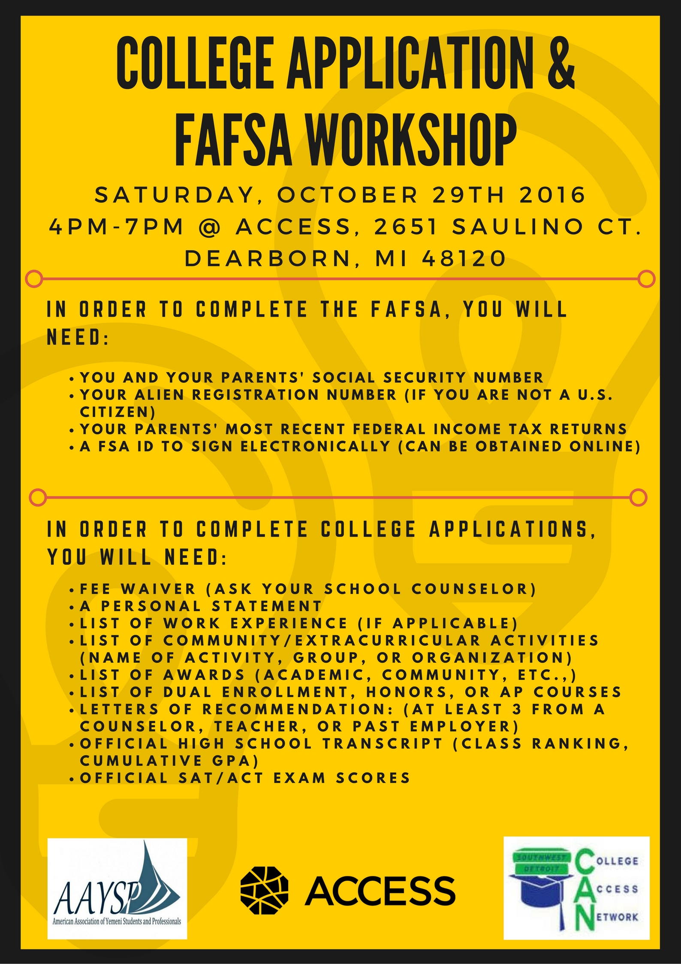

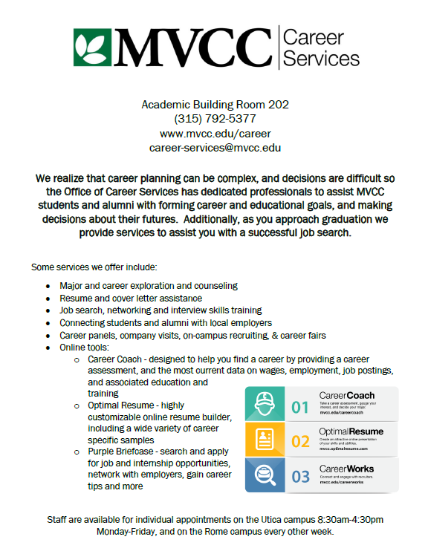
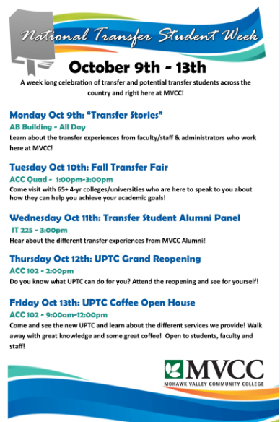



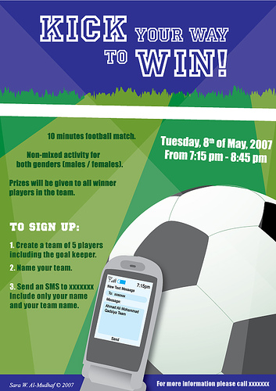
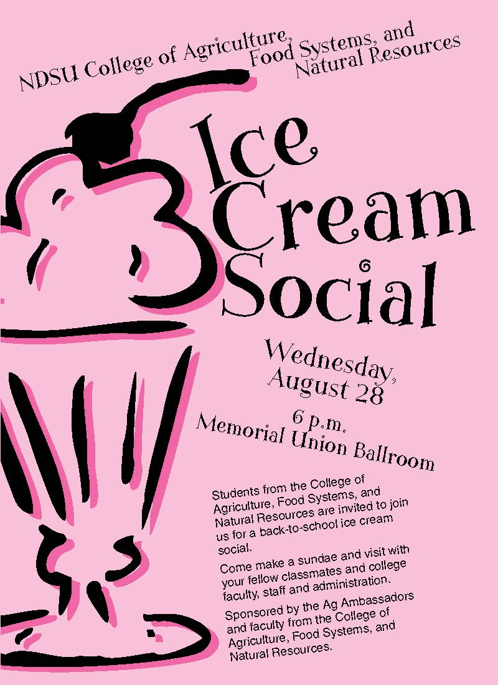

Apps, Flyers, Posters…. What works?
Michael Henningsen
Assistant Director, Career & Transfer Services
Mohawk Valley Community College

Slide 2
“Hopeful” Presentation Outcomes
Learn a couple new tech tools that could be used to connect with students to help advertise your programs that are used at MVCC
Attendees will share ideas of different strategies that are used on their own campuses
Be able to walk away with some new ideas that can help you reach transfer students

Slide 3
Why me?
Involved Community College student with Phi Theta Kappa
  Blood drives on campus—highest turnout 2 yrs in a row
Former Resident Assistant (2 yrs)
Former Assistant Hall Director (2 yrs)
  Responsible for all aspects of RA programming (16 RAs)
Former Resident Director (3.5 yrs)
Experience with LOTS of transfer programming at MVCC (7 yrs)

Slide 4
Where are all the students?
We are not alone to deal with this issue, even Athletics is seeing a decline
  2014 Wall Street Journal article noted that the “average student attendance at college footballs games is down 7.1%”
Community Colleges face difficulty as majority of our students are commuters and have other factors pulling them in many directions

Slide 5
Posters and Flyers…who sees them?
Paper blindness is real. . .
Location, Location, Location
Put them up and take them down. . .

Slide 6

Ellucian GO
App that connects to our Self-Service BANNER (SIRS)
Students able to see variety of different things:
  Events Calendar
  Class cancellations
  Class schedule
  Account messages (Billing/Financial Aid)
  Athletic information
  Faculty/Staff Directory (finding their advisor)
  Grades (when available)

Slide 7
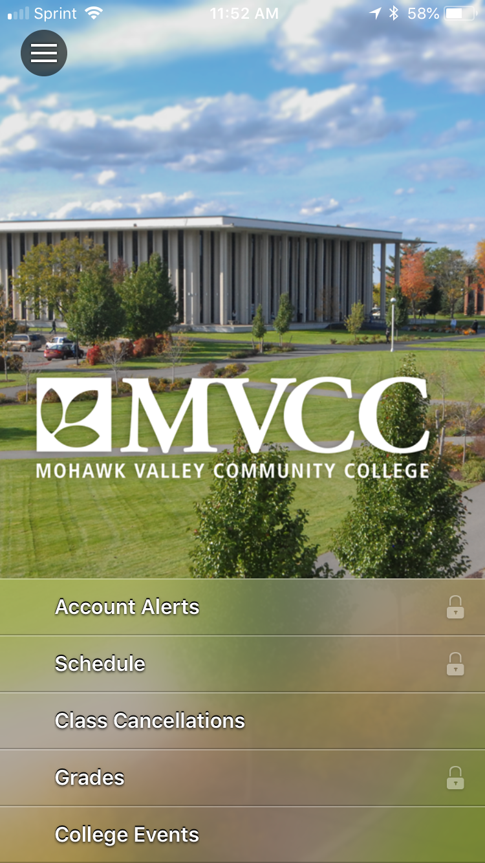
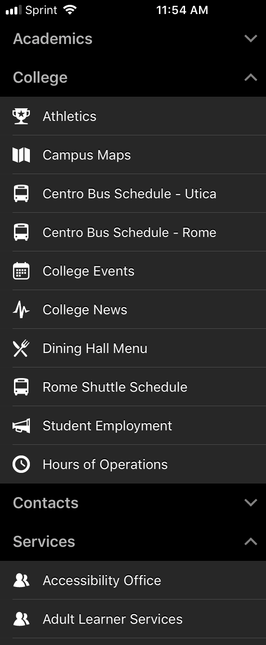
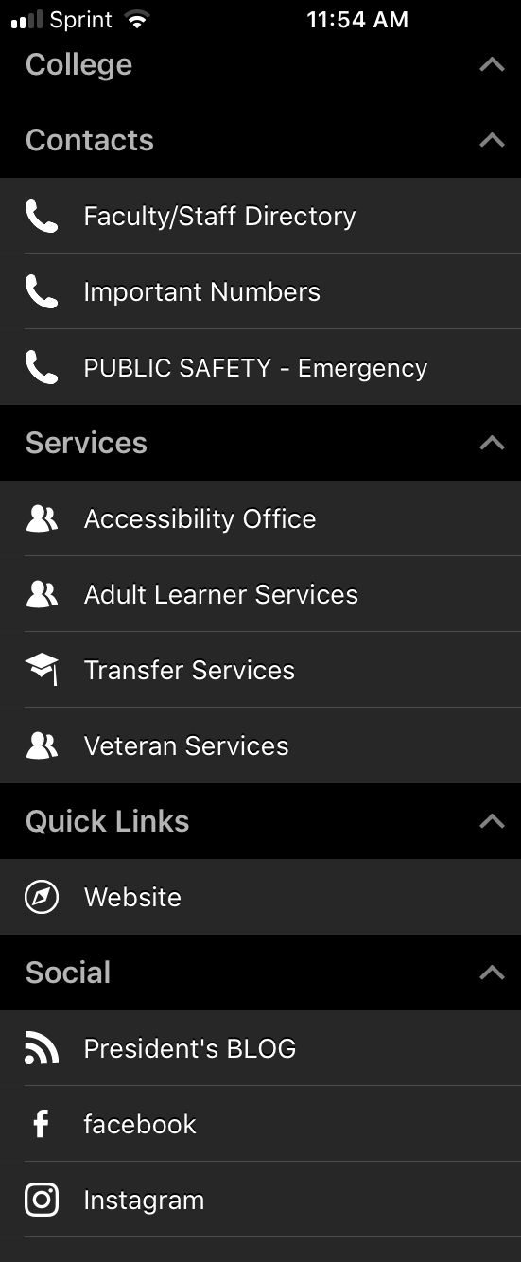
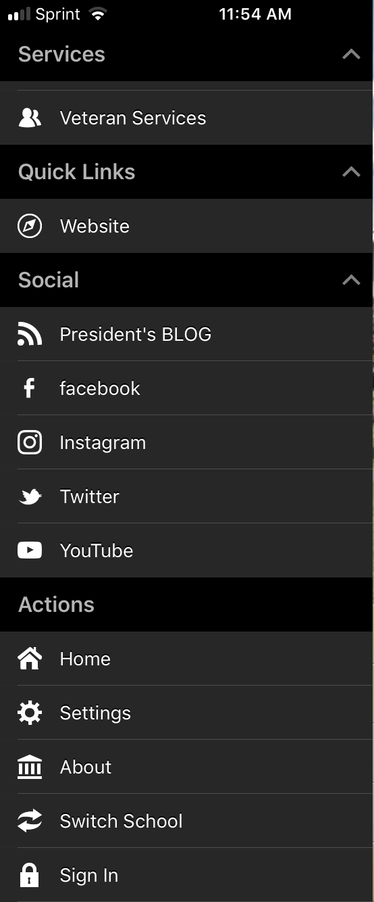

Slide 8
Ellucian GO
We are able to send targeted messages to selected students that we identify through Argos queries (major specific, credit hours, dual admit/2+2 etc)
We send a variety of messages: Priority Reg., CRs not received, Courses Not in Major, etc to specific populations.
We also send select messages to all users: Transfer related events are sent to all users
We have the ability set up beacons to send messages to users as they enter certain areas

Slide 9
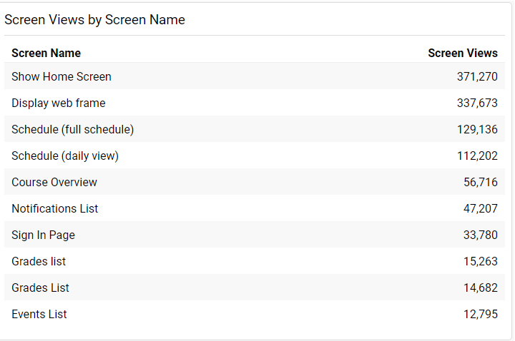
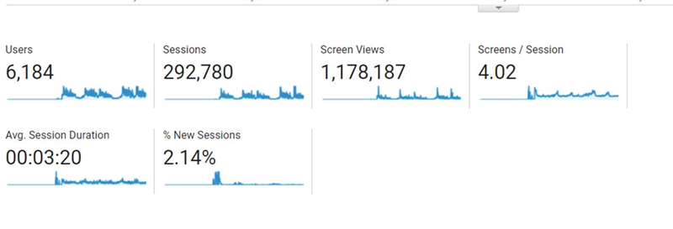
Statistical Data—Inception January 2015

Slide 10

“Hawk Life” App
“OohLaLaMobile”
This app was purchased by our Student Engagement and Outreach team, which is under our Student & Residential Life Services area.
Intent was a way to connect with students utilizing technology they are used to and constantly at their disposal.
Allows for students to connect with one another, stay up to date on events and activities, links to campus services and much more.

Slide 11
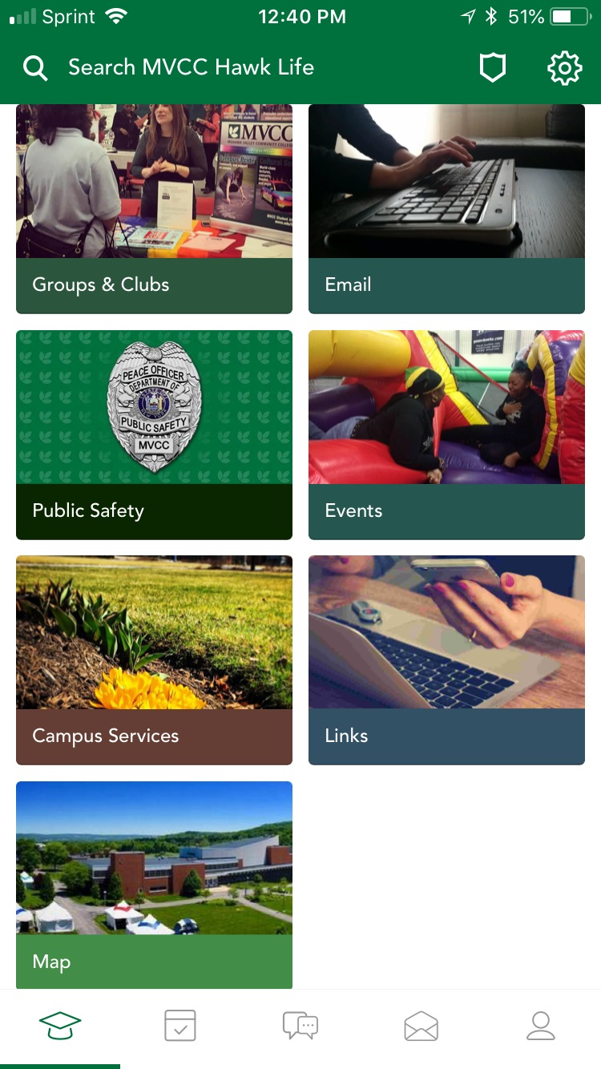
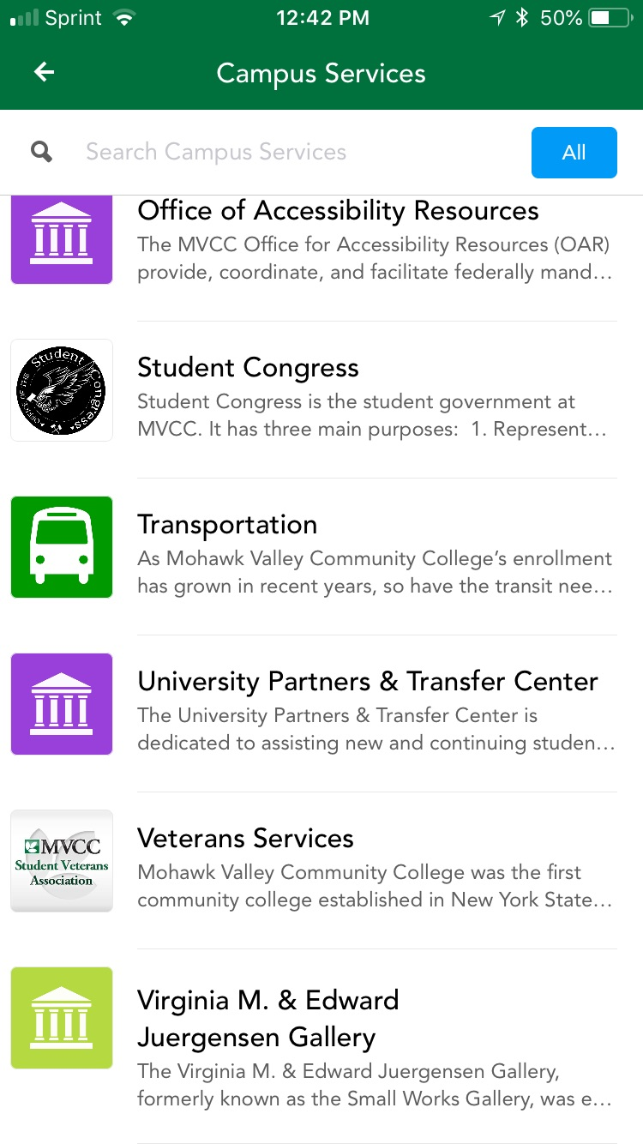
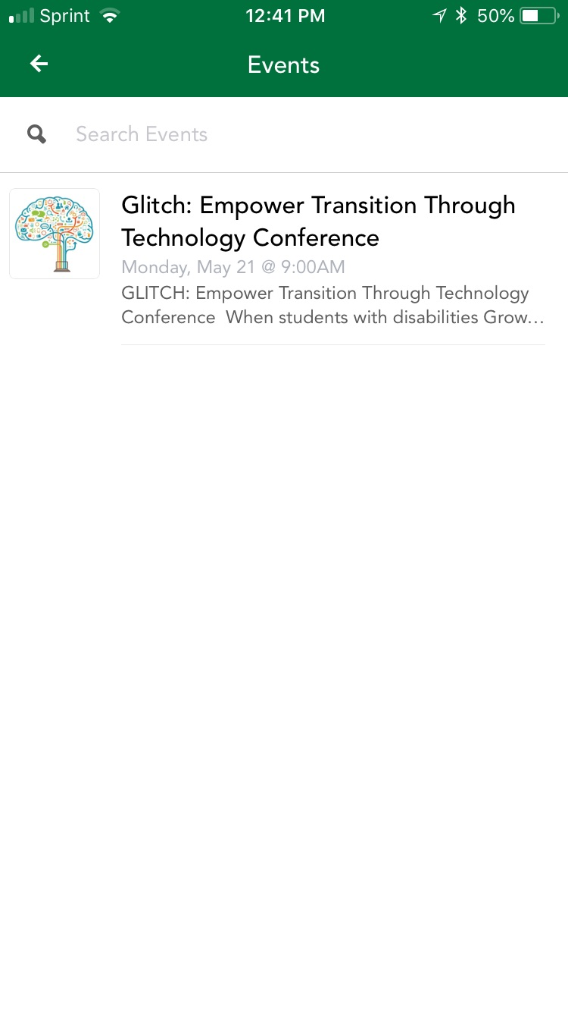
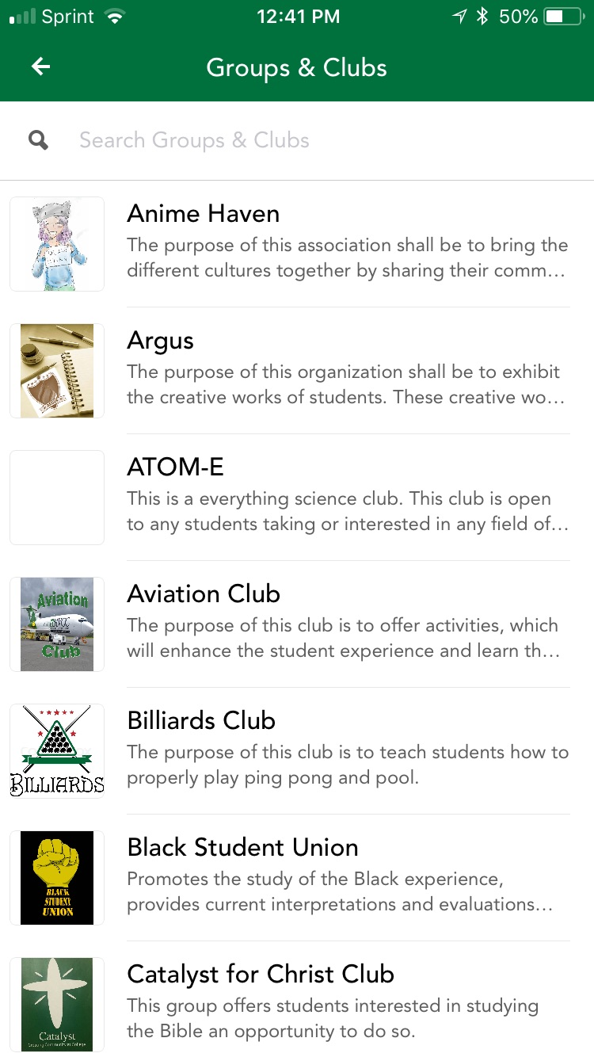
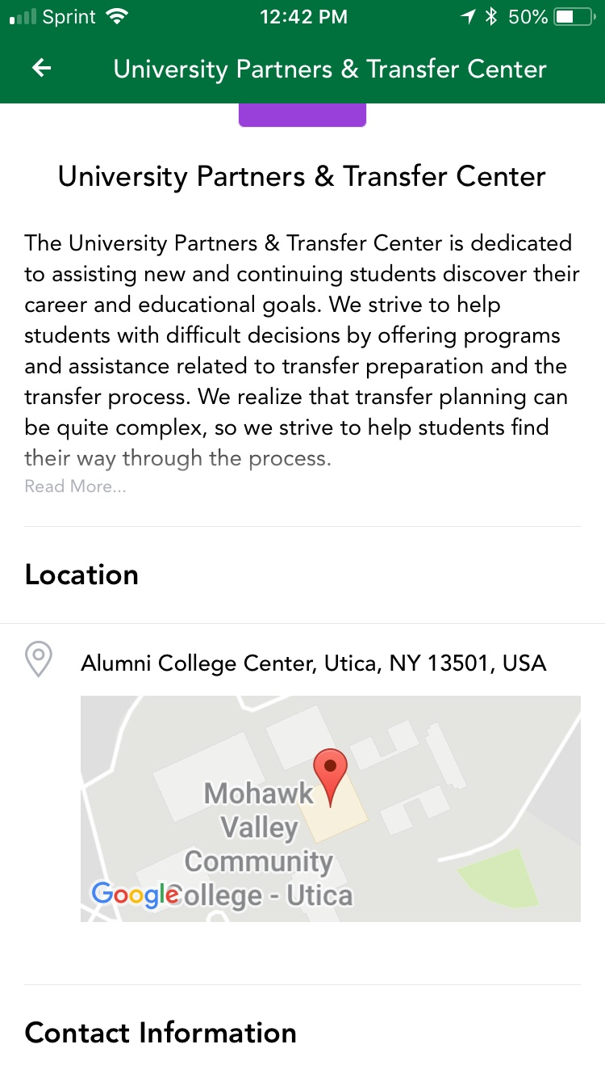

Slide 12
“Hawk Life” App
“OohLaLaMobile”
2017-2018 Statistics for Campus App
  3,136 students/faculty/staff downloaded the App
  6,320 Event Views
  907 clicks on campus services
  Over 23,000 club views
  Through the app, over 1,000 push announcements
2017-2018 Statistics for Social Activity
  Over 27,000 messages
  7,741 comments
  4,276 Connections (students connect with each other via events or club walls)
  Over 6,000 posts made

Slide 13
“Hawk Life” App
“OohLaLaMobile”
2017-2018 Statistics for Campus App
  3,136 students/faculty/staff downloaded the App
  6,320 Event Views
  907 clicks on campus services
  Over 23,000 club views
  Through the app, over 1,000 push announcements
2017-2018 Statistics for Social Activity
  Over 27,000 messages
  7,741 comments
  4,276 Connections (students connect with each other via events or club walls)
  Over 6,000 posts made

Slide 14
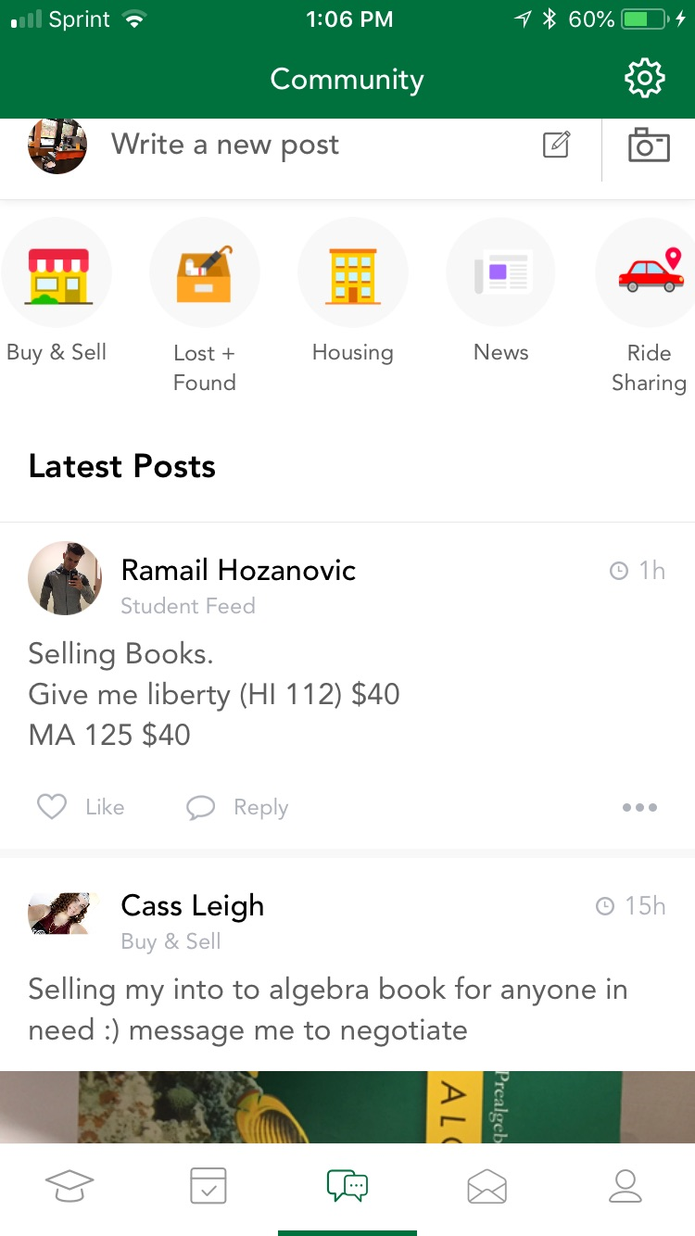
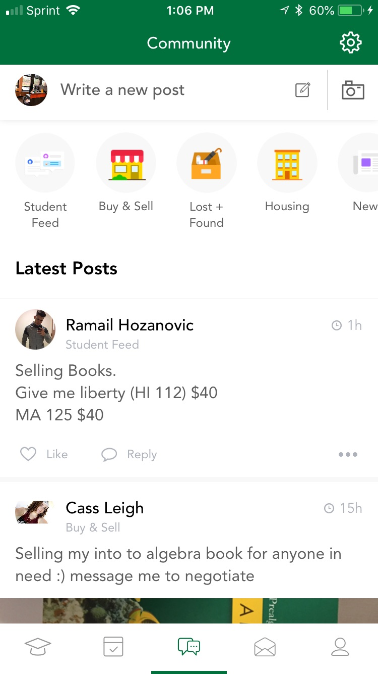
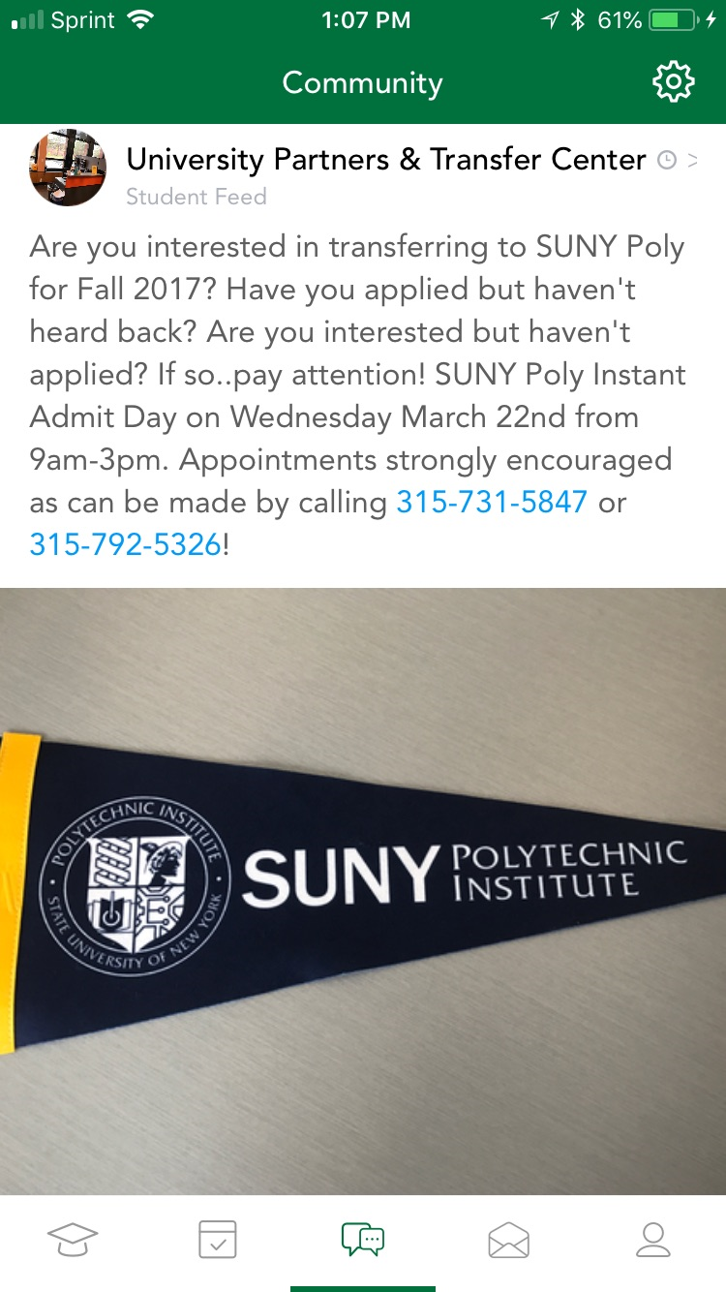
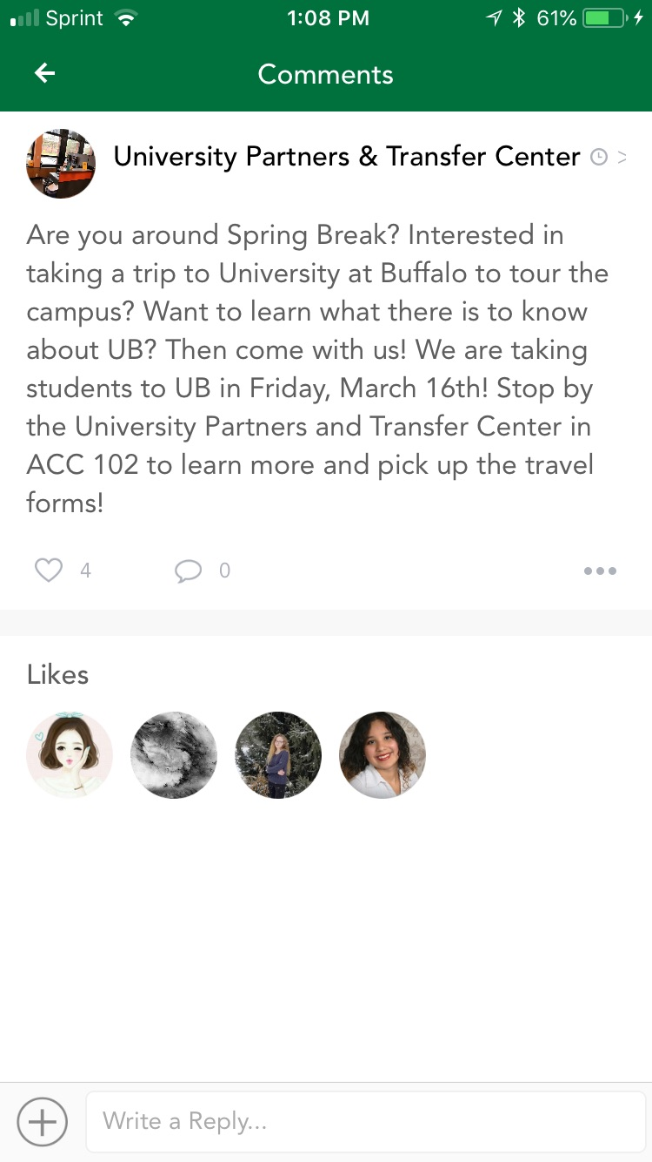
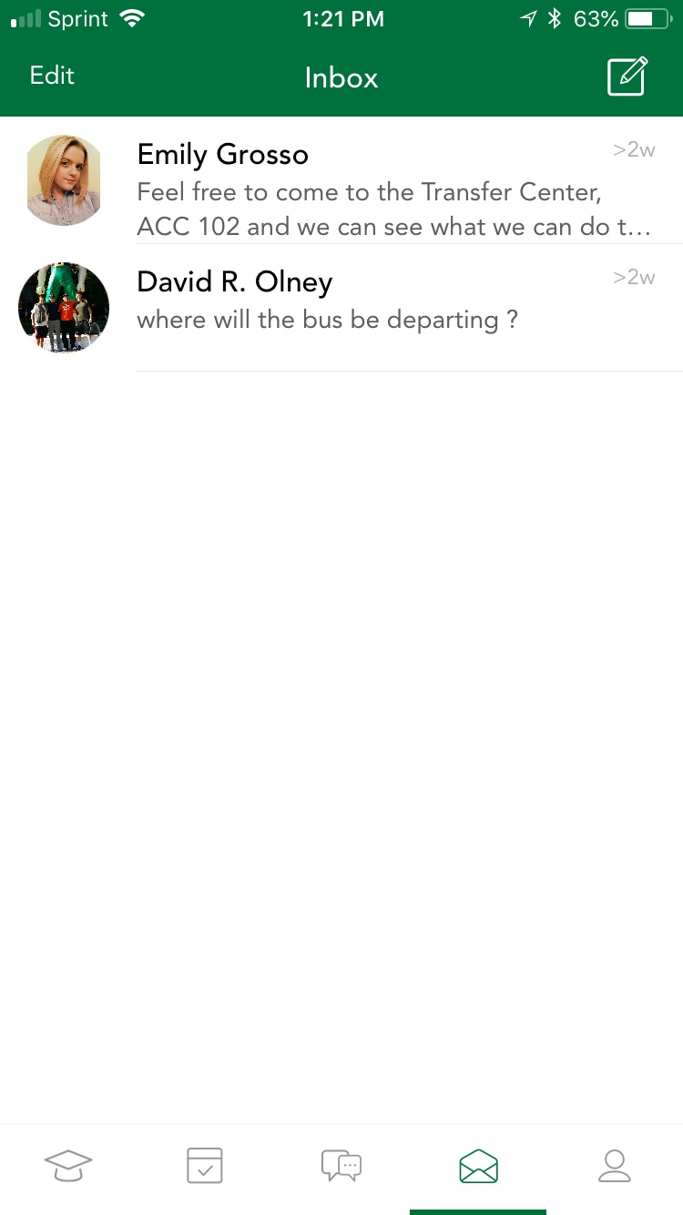

Slide 15
Other ways . . .
Administration Buy-In
Faculty Buy-In
Student Congress/Government
Special Designation for events (DGV, Leadership)

Slide 16
What do YOU do?
What works/doesn’t work on your campus?
What have you witnessed at other colleges that seem to have worked?

